Slide 1
IBM Data Science Capstone – Battle of the Neighborhoods
Alexander John Newman

Slide 2
Introduction
Amidst the Covid-19 pandemic, and facing a myriad of shutdowns nationwide, certain cities have faced more stringent regulations than others. NYC, initially being hit hard by coronavirus, has since been on a pseudo-lockdown for months, forcing people inside to live a mostly sedentary lifestyle for now
Following this pandemic, it’s not unreasonable to think that people will begin to emphasize an importance on doing what’s necessary to build up one’s immune system and exercising/working out is a very affordable way to achieve this goal. Further, people will likely look to become more active after being sedentary for so long.

Slide 3
Business Problem?
In what neighborhood of Brooklyn would it be optimal to open a new gym/fitness center?
How can we avoid saturated neighborhoods?
Is there a subset of a fitness facility that would be optimal to open?
i.e. yoga studio, weight room, Jiu-Jitsu gym, etc.

Slide 4

Data Selection
In order to obtain a general idea about possible local competition, we first need to have a basic idea of all the health/fitness centers located in the neighborhoods of Brooklyn
Google Maps API was used to find the latitudes/longitudes of said health/fitness centers (based on neighborhood postal code)
In Brooklyn, there are currently 1792 health/fitness centers

Slide 5
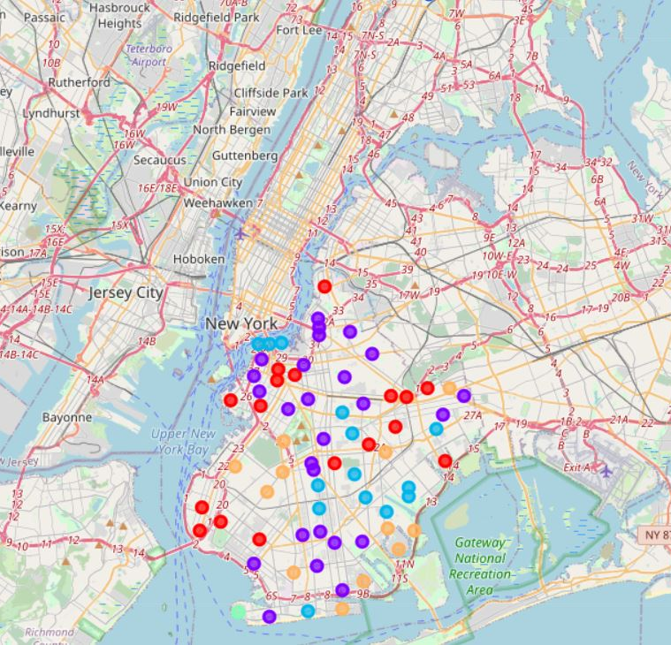
Data Selection (cont.)
Google Maps API was then used to identify neighborhoods with a lower volume of gyms
This of course allows us to avoid the saturated markets

Slide 6
Methodology
Locations are logged by their respective latitudes/longitudes
Utilize Foursquare API to explore neighborhoods in the Borough of Brooklyn, New York
With the explore function, we can sort the categories of the health/fitness centers in each neighborhood
‘Gym’ and ‘Gym/Fitness Center’ are highlighted in post to better show the findings made
Neighborhoods grouped in k-means clusters

Slide 7
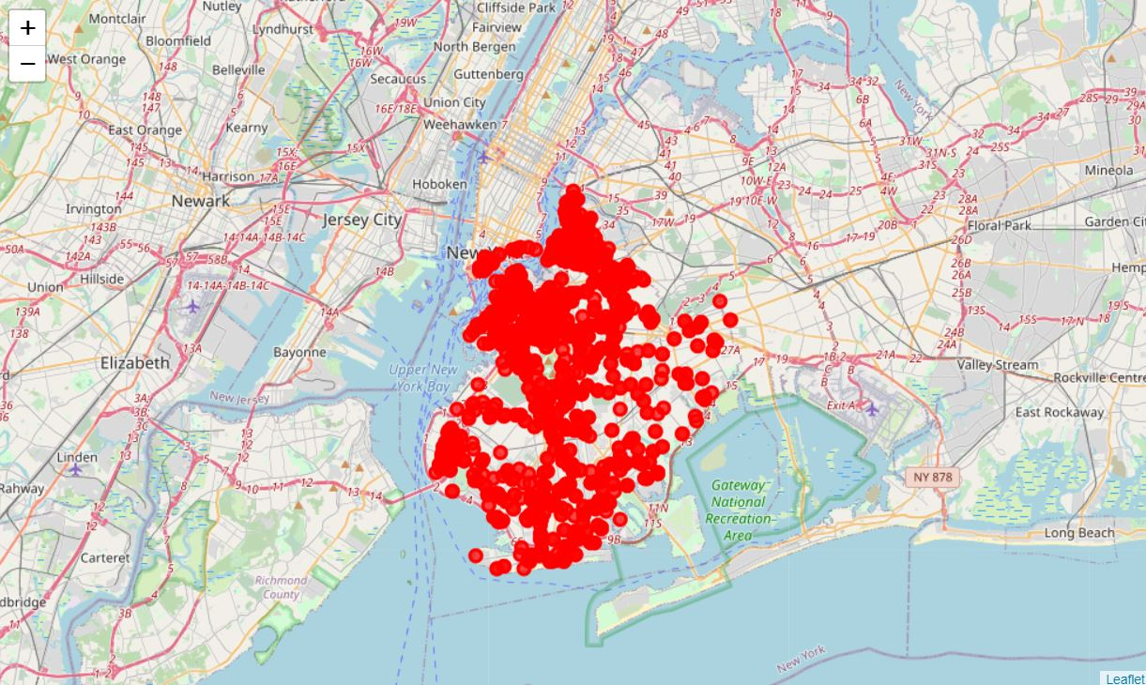
Health/Fitness Centers in Brooklyn
= areas of possible interest (low competition)
Hypothesis:

Slide 8
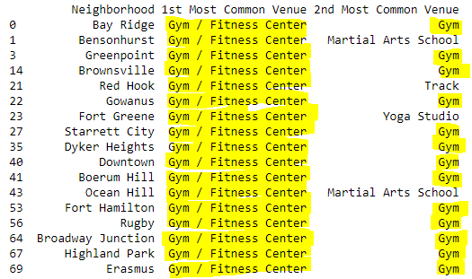
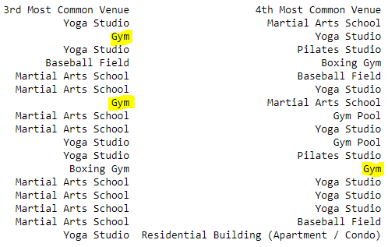
Results
Clustering data for areas with less health/fitness centers
Cluster 0

Slide 9
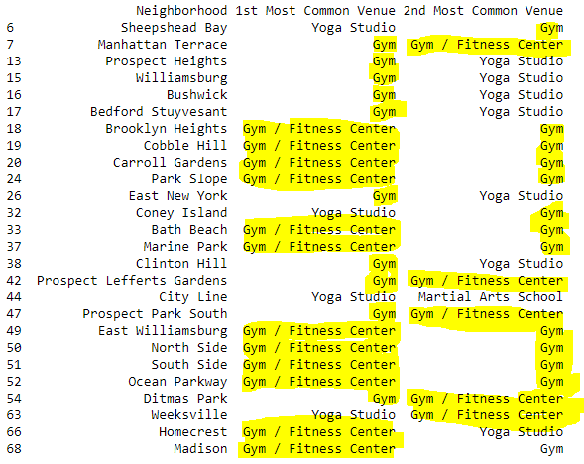
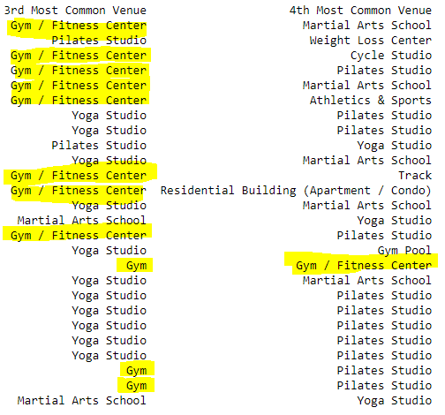
Results (cont.)
Cluster 1

Slide 10
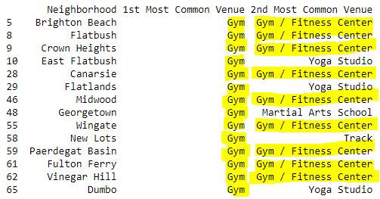
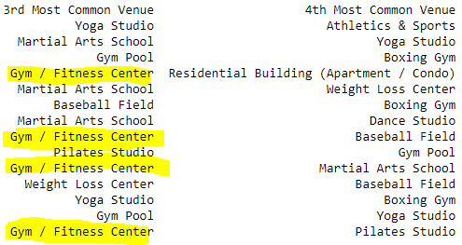
Results (cont.)
Cluster 2

Slide 11

Results (cont.)
Cluster 3

Slide 12
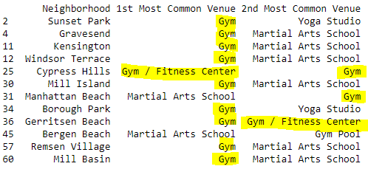
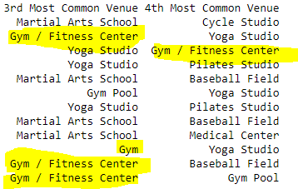
Results (cont.)
Cluster 4

Slide 13
Results (cont.)
The following neighborhoods have the lowest assumed competition among gyms based on the popularity of the gyms currently in the neighborhood
Sea Gate, Manhattan Beach, and City Line show the lowest possibility for stringent competition among gyms based on popularity
 | Cluster 0 | Cluster 1 | Cluster 2 | Cluster 3 | Cluster 4
Neighborhood | Ocean Hill | City Line | Flatlands | Sea Gate | Manhattan Beach

Slide 14
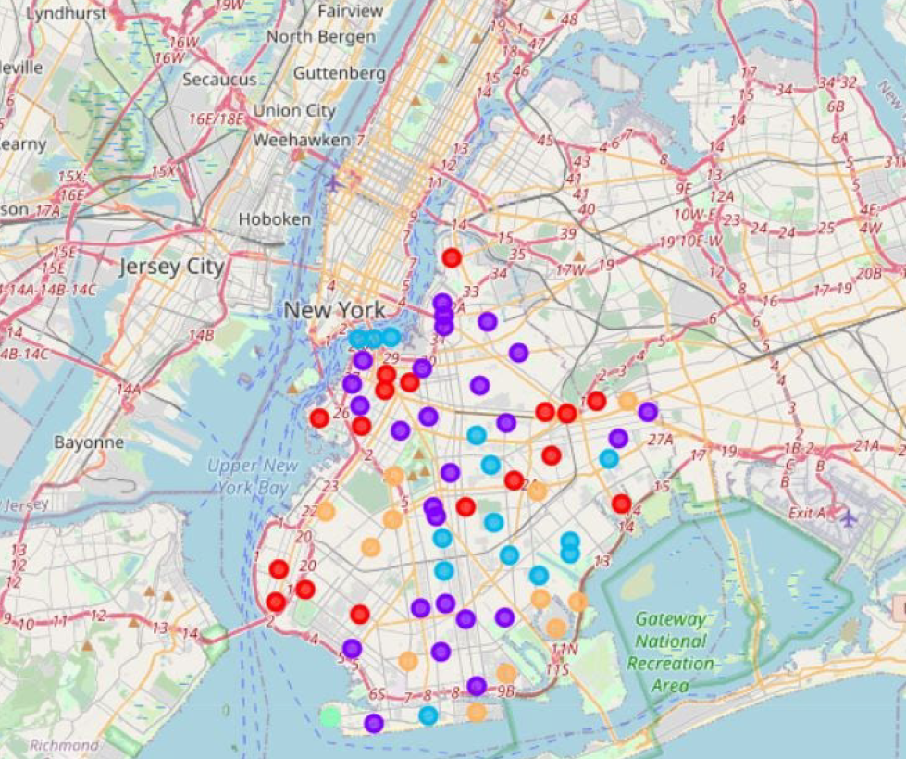
Results (cont.)

Slide 15
Discussion
Before drawing a final conclusion, it should be noted that the data used is from 2014. Seven years later now, it’s not unreasonable to think that this data may no longer be representative of the current conditions of these neighborhoods
In each cluster, the neighborhoods of least competition came out to be (from greatest to least amount of competition)
Ocean Hill, Flatlands, City Line, Manhattan Beach, and Sea Gate
The final three neighborhoods all showed similar popularity rates for gyms and gym/fitness centers
Upon further research, I’ve found that Sea Gate (private) and Manhattan Beach are both residential neighborhoods with limited real estate options

Slide 16
Conclusion
Borough Park showed to be of no interest
Bay Ridge showed to be of no interest
However, as pointed out in the hypothesis, the City Line area did show to be an area of high interest
Conclusively, given that Manhattan Beach and Sea Gate are residential neighborhoods and acquired real estate for this gym would either be far too difficult/costly, City Line has shown to be the best neighborhood with the least amount of competition to open this new gym

